Slide 1

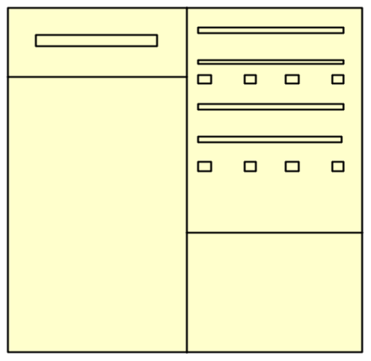

C3D BTRIS Data Extractor
FTP
Share
RDBMS
Routine Schedule
Nightly

